Slide 1

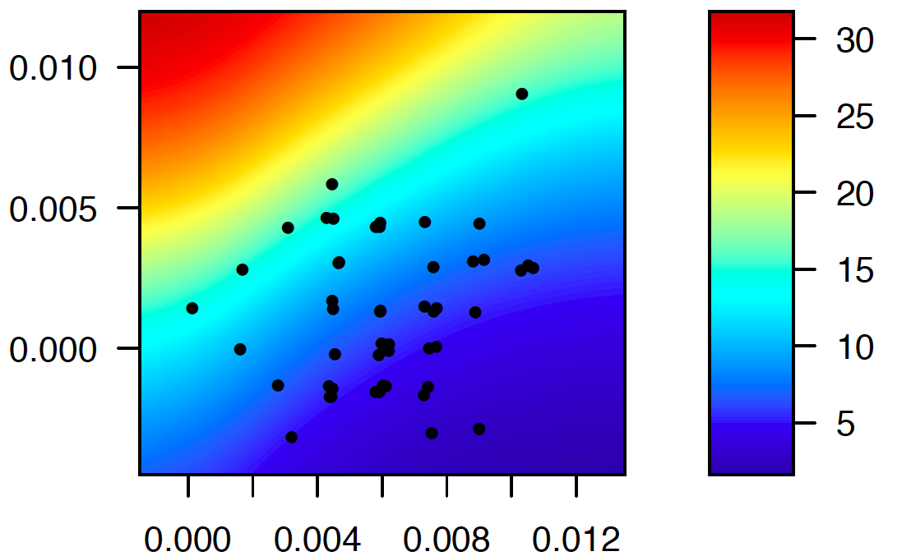
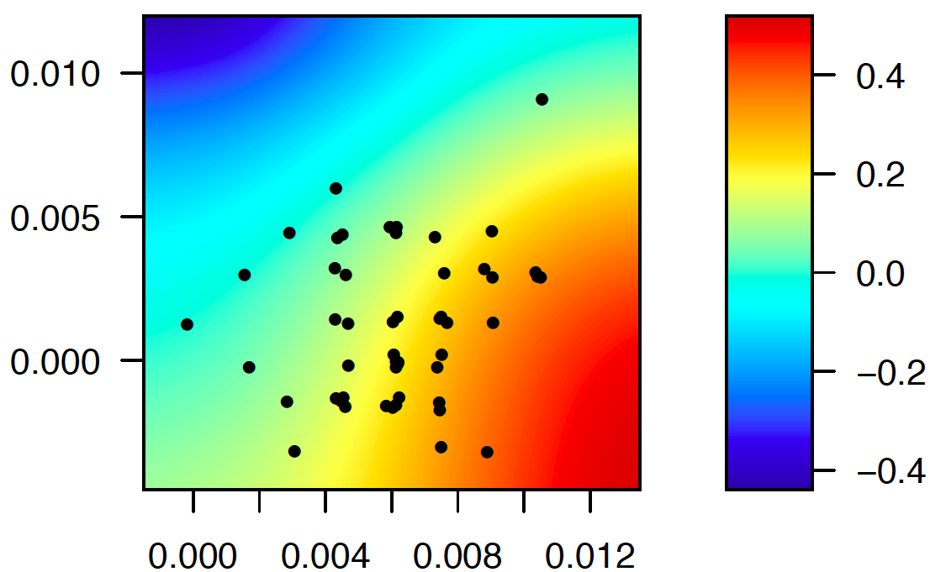
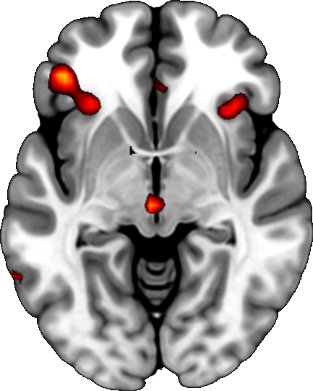
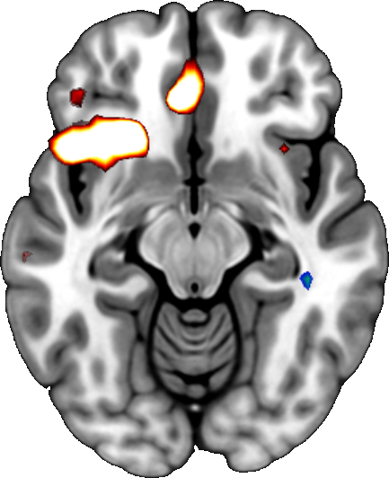
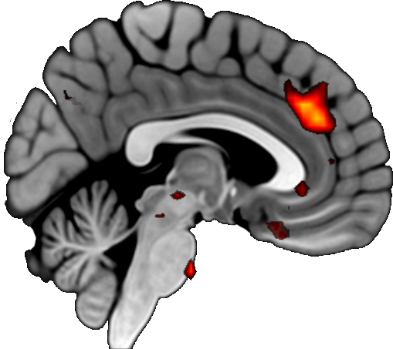
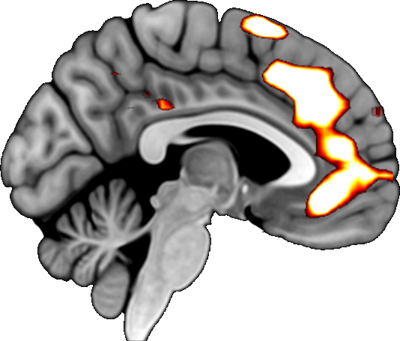

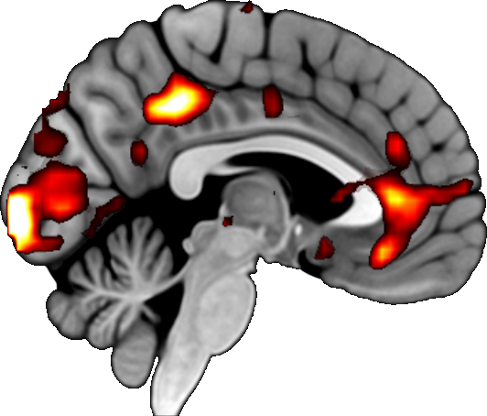


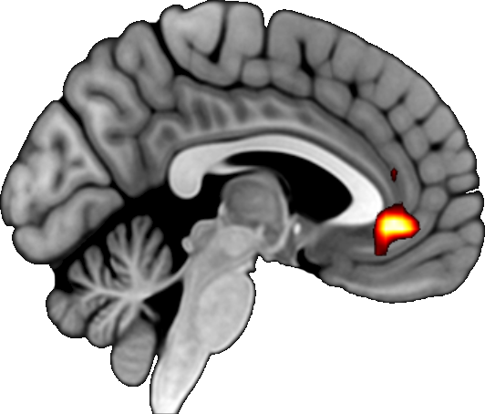
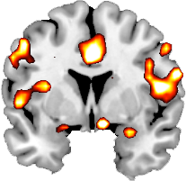
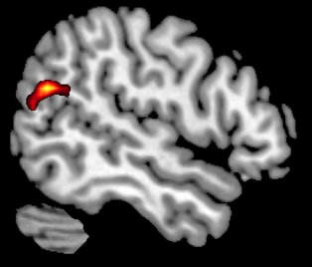
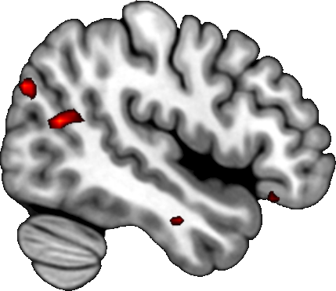
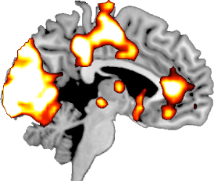
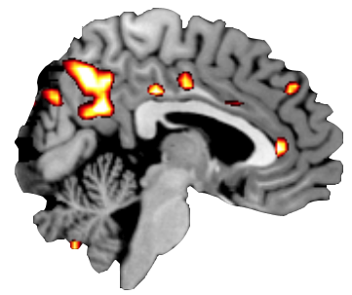
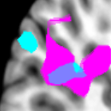
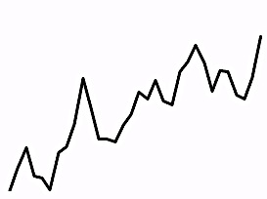
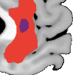
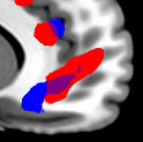
A neurocomputational model of altruistic choice and its modulation by attention
Cendri A. Hutcherson, Benjamin Bushong, and Antonio Rangel
California Institute of Technology
BACKGROUND
Effects of Model Parameters on Generosity and RT Differences
Behavioral Prediction: Generosity and RT Differences Depend on Weights
Humans often act altruistically (foregoing benefits to the self to help others) but basic mechanisms unclear.
Multiple brain regions (e.g. TPJ, ventromedial PFC, dorsomedial PFC, DLPFC) implicated in pro-social behavior, but precise roles unknown.
Unclear if altruism requires self-control to inhibit selfishness, or if acting altruistically innately rewarding
Average
Generosity
Average RT
G. vs. S.
Study 2: Altruism and RT differ by attentional focus*
Other Weight
$ Given
Other Weight
G vs. S RT
GOALS
• = indiv.Pp
• = indiv.Pp
*Model fitting suggests that the only parameters that vary between the conditions are w_{self} and w_{other}.
Develop a computational model of altruistic choice that accounts for generous (G) and selfish (S) choices, as well as reaction time (RT)
Use model to derive predicted activity in regions related to reward, cognitive control, and social cognition
Self Weight
Self Weight
Generous choices slower if w_{self} > w_{other}
Neural Prediction: Comparator Activity on G vs. S Choice Changes w/ Weights
Individual subjects generally have w_{self} > w_{other}
Generous choices faster if w_{self} < w_{other}
Fitted Parameters Produce Close Match to Observed Choice and RT
Study 1
Study 2
Model captures response to proposals
Model captures RTs G vs. S Choice
Ins/IFG: G vs. S trials
Ins/IFG: G vs. S Natural trials
METHODS
Model RT
Model
G vs. S Choice RT
Mean BOLD
**
Participants: Study 1: 51 Pps; Study 2: 42 Pp ( + anon. partners )
Scanning Task: Each trial involved a choice between displayed payoffs to self and partner vs. an even split to both. Choice implemented probabilistically after response. One trial chosen at end determined pay for both participants.
Attentional focus manipulation:
Study 1: 180 trials, Pps. instructed to choose what they preferred
Study 2: 90 trials/ condition, Pps asked to attend in 3 ways:
Respond Naturally: Allow natural thoughts and feelings.
Focus on Ethics: Justice and ethical/moral implications of choice.
Focus on Partner: Happiness of person affected by your choices.
Acceptance Rate
Response Time
A
B
C
D
E
F
G
H
I
A
B
C
D
E
F
G
H
I
Model: Ave. $ Given
dmPFC: G vs. S trials
dmPFC: G vs. S Natural trials
Offer Type
Offer Type
G vs. S Choice
Reaction Time
Offer Type ($Self, $Other)
Observed
Reaction Time
A = 25,75
B = 25,100
C = 50, 10
D = 50, 100
E = 75, 10
F = 75, 25
G = 100, 10
H = 100, 25
I = 100, 50
Mean BOLD
**
Choice
ISI
Outcome
ITI
Ave. $ Given
4 sec
1-3 sec
3 sec
1-6 sec
Neural Prediction: Encoding and Integration of $Self and $Other
vmPFC Preference – All trials
vmPFC Preference – All trials
+
+
60%
Self Other
+
DDM suggests that simple model with variables $Self and $Other captures choice and RT. Are $Self and $Other encoded in the brain?
Self Other
35
6
35
6
Self Other
—1—2—3—4—
20
20
Study 1
Study 2
40%
Correl. w/ $Self
Correl. w/ $Other
Correl. w/ $Other
Mean BOLD
**
r Amygdala
r TPJ
r TPJ
* Regions displayed at P < .001, uncorrected
y = +3
CONCLUSIONS
x = +52
Study 1
Simple drift diffusion model in which weighted sum of $Self and $Other is integrated into overall value fits choice, RT, and neural data across 2 studies
Neural results tie TPJ specifically to computations of others’ welfare, and vmPFC to integration of both.
Model suggests that G vs. S choices are not rewarding or control-dependent per se, but show different patterns as a consequence of the structure of the comparator process
COMPUTATIONAL MODEL
vmPFC
vmPFC
x = +48
Study 2
x = -4
x = +4
+B
Drift diffusion model w/ 5 parameters:
w_{self} and w_{other}
Non-decision time NDT
Barrier ±B and collapse rate r
Relative decision value RDV at time t:
w_{self}*($Self – default) + w_{other}*($Other – default) + ε_{t}
Choice made when RDV_{t} crosses ±barrier
Overlap (Integration)
Overlap (Integration)
Choice
Accept
$Self
$Self
NDT
RT
Parametric
association
RDV
t
$Other
$Other
ACKNOWLEDGMENTS
Reject
$Self
$Other
Financial support from the Gordon and Betty Moore Foundation, and from the NIH in the form of a Conte Center Grant is gratefully acknowledged. Address correspondence to Cendri Hutcherson (chutcher@caltech.edu)
-B
* Regions displayed at P < .005, uncorrected

